Slide 1
FT900 Alexa Demo
For PanL Smart Home

Slide 2




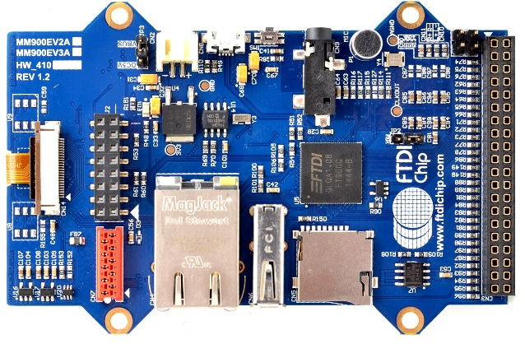
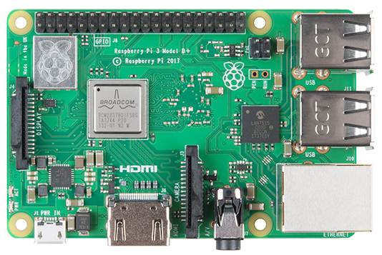
ft900 alexa demo
for PanL Smart Home
microphone
speaker
alexa sdk
ETHERNET
WIFI
RS485
ft900
rpi 3b+

Slide 3

1
2
3
Alexa Virtualization
8
4
7
6
5
Multiple FT900 clients connected to different Alexa instances/accounts

Slide 4
1
User Presses FT900 Button
User presses down a button on FT900 to start voice
recording and releases it to stop recording.
2
User Talks to Alexa on FT900 Microphone
User commands Alexa to turn on a smart home device
and FT900 saves the voice recording on SD card.
3
FT900 Sends Alexa Request to RPI
FT900 sends the compressed voice recording to RPI
and RPI receives the voice recording and decompresses it.
4
RPI Relays Alexa Request to the Cloud
RPI sends the Alexa request to the cloud
and receives the AI-generated Alexa response.
5
RPI Relays Alexa Response to FT900
RPI decodes Alexa response from MP3 format to raw
PCM format, compresses it and sends it to FT900.
6
FT900 Receives Alexa Response from RPI
FT900 receives compressed audio from RPI,
decompresses it and saves it to SD card.
7
FT900 Plays Alexa Response on Speaker
FT900 reads audio from SD card
and plays it on the connected speaker.

Slide 5
DIALOG
Ask information, control devices
ALERTS
Set alarms, timers
CONTENT
Play music, audio book, live news

Slide 6
FT900 Alexa Demo
Demonstrates FT900 as an Amazon Echo Dot
Just like Amazon Echo, users can issue voice commands to Alexa and hear Alexa’s voice responses generated by Alexa’s speech recognition and natural language processing in the cloud.
Uses RPI as Alexa gateway
FT900 (Alexa client) communicates with a Raspberry PI 3B+ (Alexa gateway), which relays voice requests and voice responses to and from the Alexa cloud.
RPI runs a customized version of Amazon’s official Alexa Voice Service (AVS) SDK, written in C++.
Added Alexa Virtualization feature
RPI supports Alexa Virtualization feature enabling multiple MCU clients to simultaneously access Alexa using multiple Alexa instances and different Amazon accounts.

Slide 7
PanL Smart Home with built-in Alexa
Targets FTDI/Bridgetek’s PanL Smart Home products
PanL Hub and PanL Display.
PanL Hub, which runs on RPI, will act as the Alexa gateway while the PanL Display, which runs on FT900, will act as the Alexa client.
Having Alexa built-in to PanL products
Allow customers to talk directly to Alexa via PanL
No need for Amazon Echo devices
Make PanL more marketable

Slide 8
FT900 Alexa Client
FT900 Alexa Demo Application
Alexa AVS library
BUTTON
Free RTOS
AUDIO
Speaker, Microphone, Compression
MEMORY WRAPPER
COMMUNICATION WRAPPER
sdcard
flash
rs485
ethernet
wifi
fatfs
lwip
at
I2S
I2C
SDHost
SPI
RS485
Ethernet
UART
GPIO
ESP32

Slide 9
RPI Alexa Gateway
AVS SDK SampleApp
Connection Handler
Client Handler
Audio
Compression
Request Handler
Response
Handler
Display Card
Manager
Audio Rate
Conversion
Request Manager
Response Manager
GuiRenderer
Audio
Decoding
Request
Hook
Response Hook
Port Audio
Microphone
AVS SDK library

Slide 10
RPI Alexa Gateway
AVS SDK SampleApp
AVS SDK library
Capability Agents
Speech Synthesizer
Alerts
Audio
Player
GStreamer Media Player
Media
Player
Attachment ReaderSource
IStream
Source
BaseStreamSource

Slide 11
Gstreamer Audio Pipeline Hooking
appsrc
decoder
decoded
Queue
converter
volume
audio sink
equalizer
caps
resample
fake sink
audio queue
tee
app queue
app sink
Added a tee branch to output to both appsink and audiosink
Replaced audiosink with fakesink to disable audio playback

Slide 12
Different Alexa instances & Amazon accounts
AlexaClientSDKConfig.json
app
db
PORT_BASE
Alexa Manager
Script
automated configuration & execution
AlexaClientSDKConfig2.json
app
db2
PORT_BASE + 1
AlexaClientSDKConfig3.json
app
db3
PORT_BASE + 2

